Slide 1
Cognition Fundamentals: Decision-making & Actions
How do we learn from our perceptions?
Responsible Lecturer: Bram Heijligers

Slide 2
What we learn and why
Learning Objectives
Sample relevant real-world input required for situational awareness & reinforcement learning.
Sample cognitive processes used to process relevant real-world input required for situational awareness & reinforcement learning.
Using situational awareness & reinforcement learning to respond.
→ feeds into our reinforcement learning algorithm & symbolic AI and helps to optimize it
→ how we process input and take appropriate action on it
→ how we execute the bin-picking task

Slide 3
What is situational awareness?
Types:
Conscious
Subconscious

Slide 4
“Most of the processing in the brain is not available to conscious inspection” (Styles, p. 6)
Attention
Selection of a subset of information for further processing
Depending on the sensory stimulus (visual, auditory, multisensory…)
Active (controlled by individual’s goals) vs. Passive (controlled by external stimuli) – top-down vs. bottom-up
Focused (selective - sustained) vs. Divided (multitasking)
Internal (internal processes; endogenous) vs. External (external stimuli; exogenous)
Processing resources allocated to perform a cognitive task
Outcome of processing that allows us to process certain input
Control of attention also involves (executive) action

Slide 5
How do I achieve situational awareness
What input do we need to understand a given situation?
Conceptual understanding of the individual element of the environment
Prior-knowledge of individual elements which situation
Causal relationships between the individual elements
Conscious vs. unconscious information processing (Salti, Harel, & Marti, 2019)
3 factors that influence this process:
Context
Stimulus saliency
Observer’s goals

Slide 6
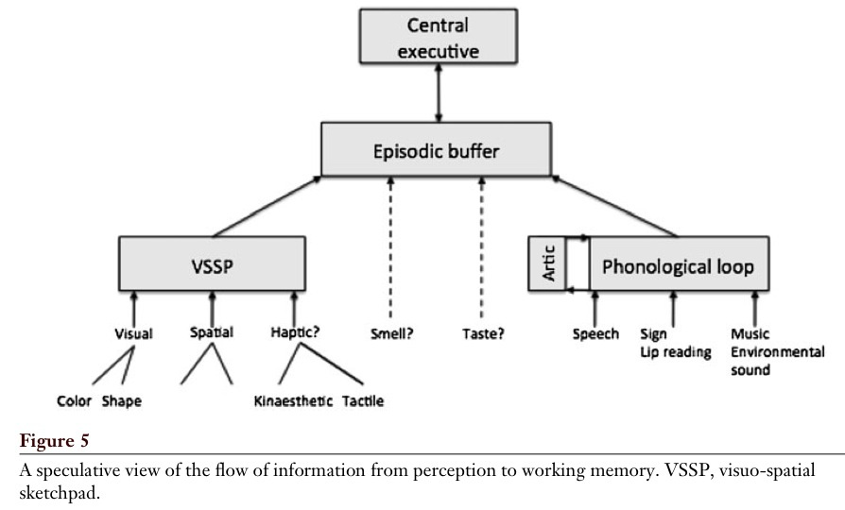
Working Memory
Baddeley, 2012

Slide 7
Central executive
Most important component of WM
Has limited capacity, deals with demanding cognitive tasks, resembles attention
Is related to executive processes (processes that organize and coordinate the functioning of the cognitive system to achieve current goals)
Baddeley (1996 – cf. Miyake et al.):
- focusing attention or concentration
- dividing attention between two stimulus streams
- switching attention between tasks
- interfacing with long-term memory

Slide 8
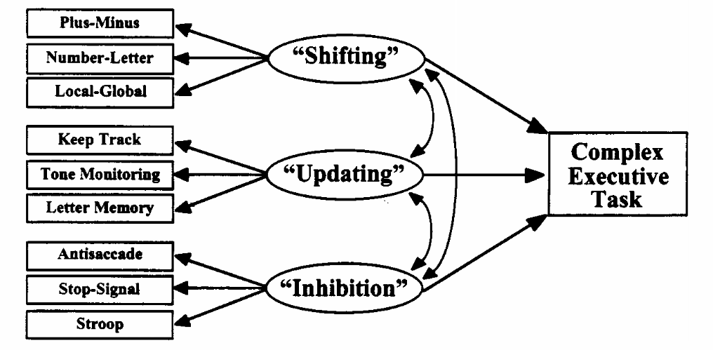
Executive Functions

Slide 9
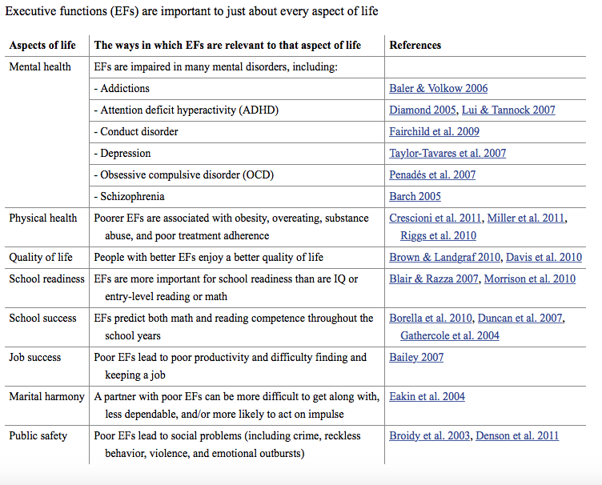
Executive Functions

Slide 10
Multisensory Challenges
Two fundamental computational challenges that the brain faces:
Causal inference problem: Do signals come from common sources and should they thus be integrated?
Perceptual inference problem: Assuming a common signal source, what is the relative reliability of each unisensory feature? (think of visual and auditory cues to specific phonemes)
Bayesian causal inference
Rubber hand illusion
Gottlieb, 2018

Slide 11

Rubber Hand Illusion

Slide 12
Conditional Probabilities
Drawing without replacement (reducing the set of possible outcomes)
P(A|B) – probability of event A assuming B
In general: P(A|B) ≠ P(A)

Slide 13
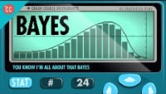
Conditional Probabilites

Slide 14
Conditional Probabilities
Bayesian inference: update probabilities as new information becomes available
Bayes’ Theorem:
P(B|A) • P(A)
P(A|B) = ________________
P(B)
Prior probability
(A before we observed B)
Posterior probability
(A after we observed B)
Probability
of observing B
Probability
of observing B given A (likelihood)

Slide 15
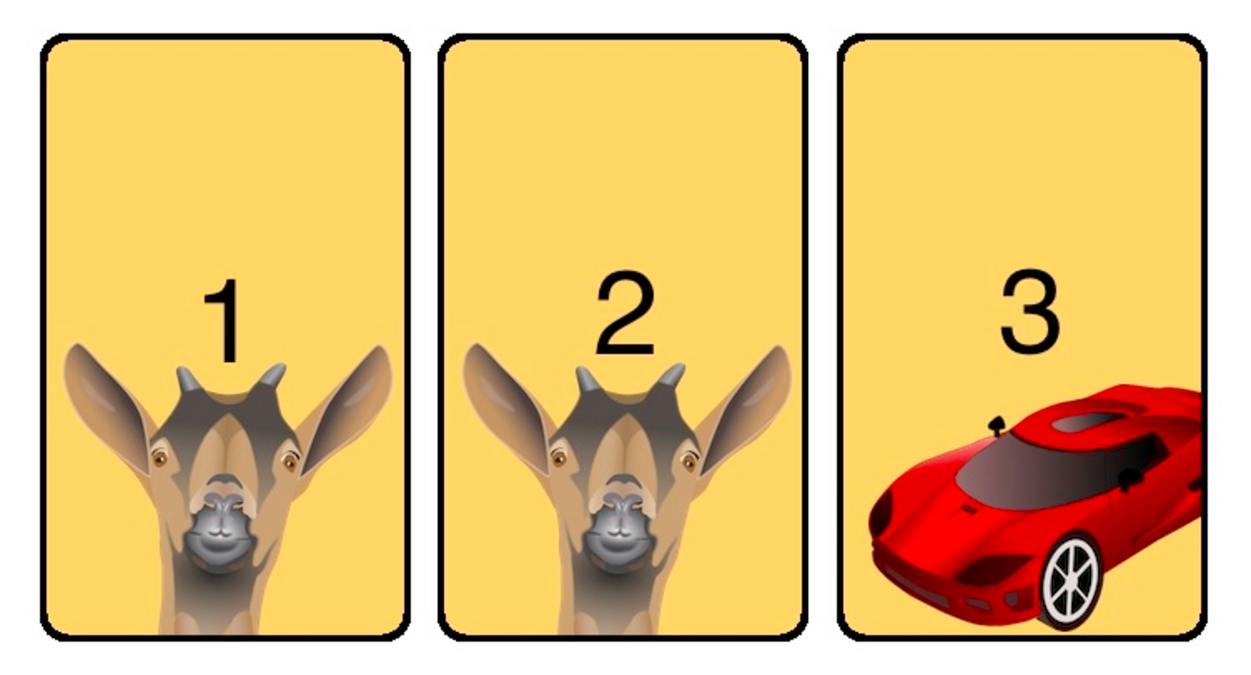
Monty Hall Problem

Slide 16
LTM: Familiarity vs. Recollection
Familiarity – observer knowing an item is old or new, without having specific details associated with that memory; the process of recognizing an item on the basis of its perceived memory strength but without retrieval of any specific details about the study episode
Recollection – observer accessing specific details about a previously experienced item

Slide 17
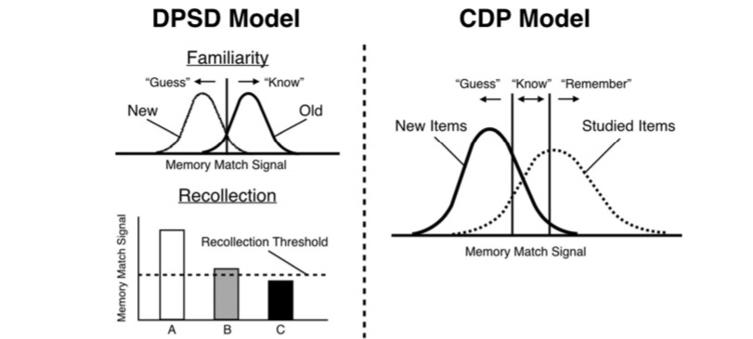
Familiarity vs. Recollection: The DPSD and CDP Models
Notes:
DPSD = dual-process signal-detection
CDP = continuous dual process

Slide 18
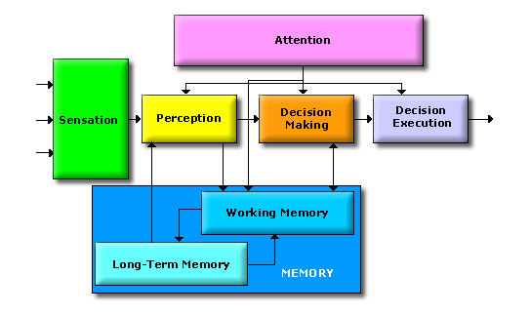
What is a decision?
Dependent on situational awareness
Dependent on the (un)certainty of the environment and processes within
Dependent on agent motivation

Slide 19
How do we make decisions?

Slide 20


Slide 21


Rewards & Motivation
Motivation is what motivates us; lies at the base of intelligence
Reinforcement Learning is learning what to do and how to map situations to actions. The end result is to maximize the numerical reward signal. The learner is not told which action to take, but instead must discover which action will yield the maximum reward.

Slide 22
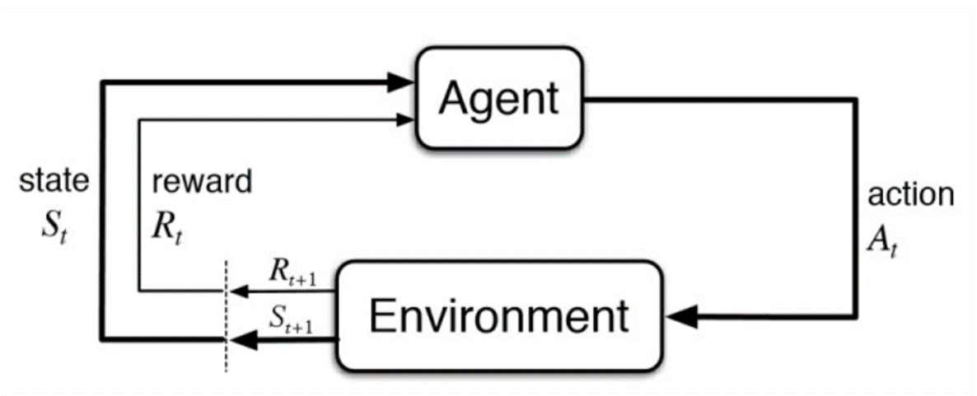
Reinforcement Learning
Reinforcement Learning is learning what to do and how to map situations to actions. The end result is to maximize the numerical reward signal. The learner is not told which action to take, but instead must discover which action will yield the maximum reward.
What happens in our cognitive and robotics model is located inside the agent bubble. Question now is; would it also be valuable to work out the environment for our flowchart?
Notes:
Reinforcement Learning is learning what to do and how to map situations to actions. The end result is to maximize the numerical reward signal. The learner is not told which action to take, but instead must discover which action will yield the maximum reward.

Slide 23
Active Sampling
Some more information

Slide 24
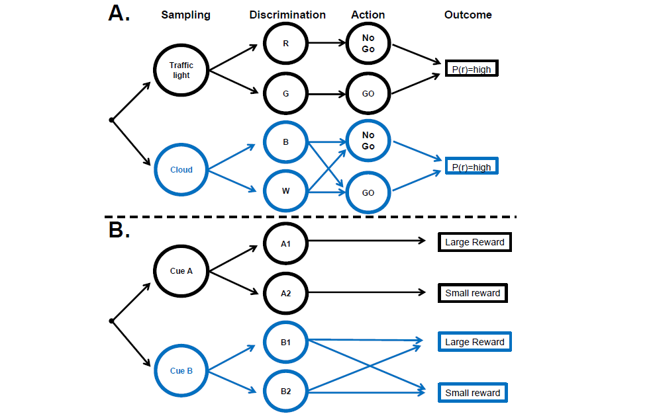
Decision chains for sampling and action
Gottlieb, 2018

Slide 25
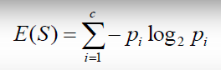
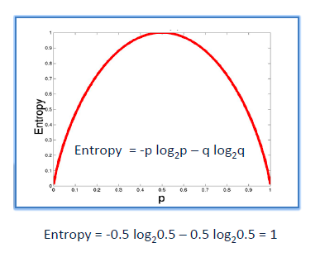
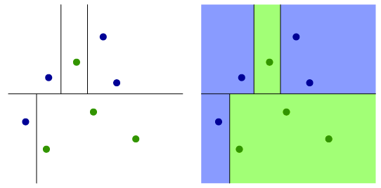
Information gain/Reduction of Uncertainty
It is like playing “20 questions”
ENTROPY = measure of disorder of a system
Zero entropy ~ completely homogeneous sample
Entropy = 1 ~ the sample is equally divided
ENTROPY

Slide 26
What action to take?
Now that we have established how we make a decision in a geiven situation, we can start taking actions to reach our goal

